Slide 1
Simulation Resualts

Slide 2
The plots can provide an indication of useful things about the training of the model, such as:
Its speed of convergence over epochs (slope)
Whether the model may have already converged (plateau of the line)
Whether the mode may be over-learning the training data (inflection for validation line)
And more
I think both model can train more because they still showing improvement and the slope do not flat yet.

Slide 3
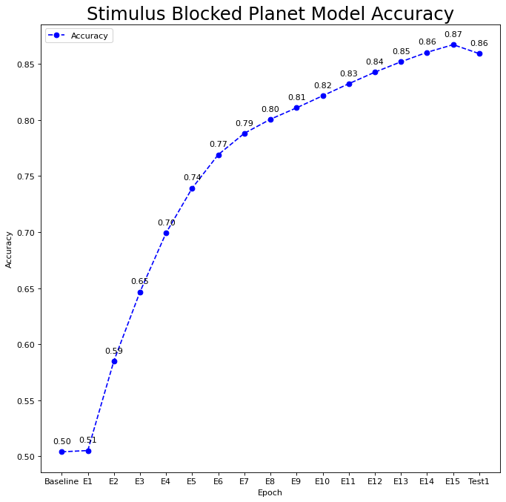
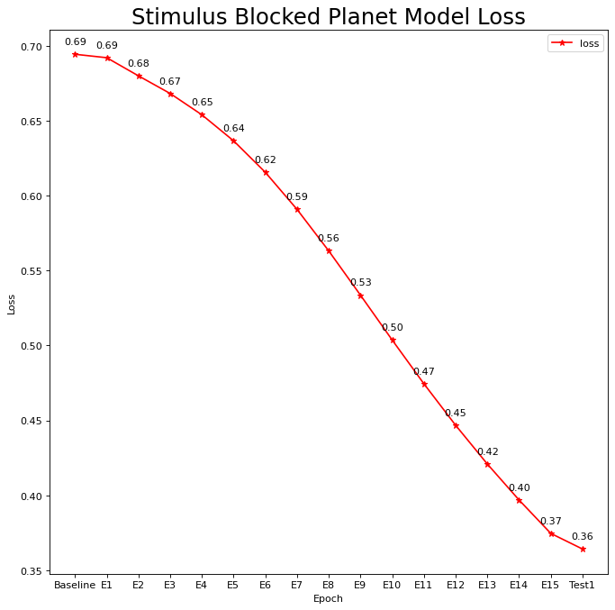
Stimulus Blocked Planet(Yes/No): SAEM SCALE
Epochs=15, 500 times simulation

Slide 4
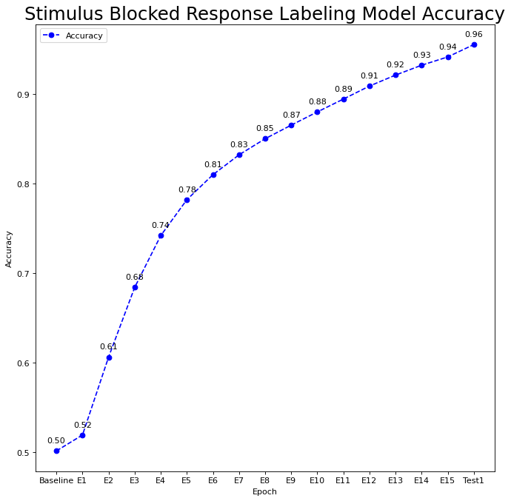
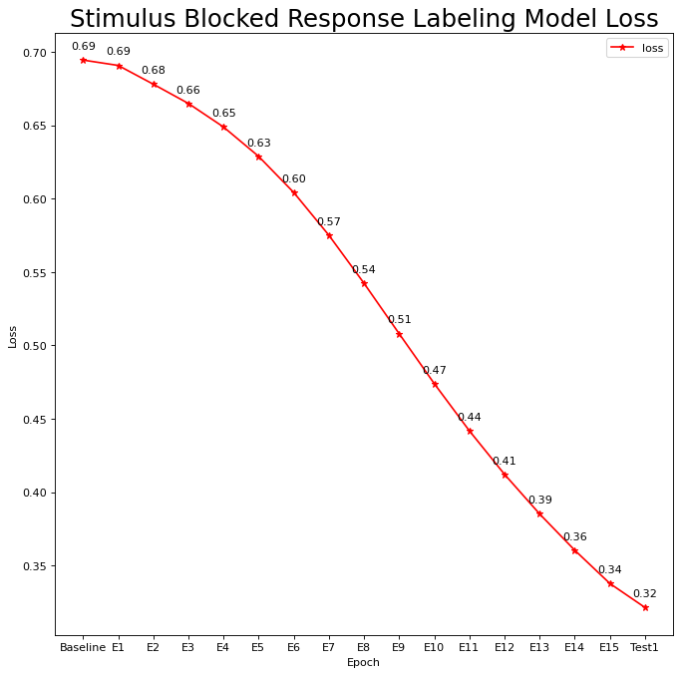
Stimulus Blocked Response Labeling(6 Response):
Epochs=15, 500 times simulation

Slide 5


Stimulus Blocked Planet
Stimulus Blocked Response Labeling

Slide 6
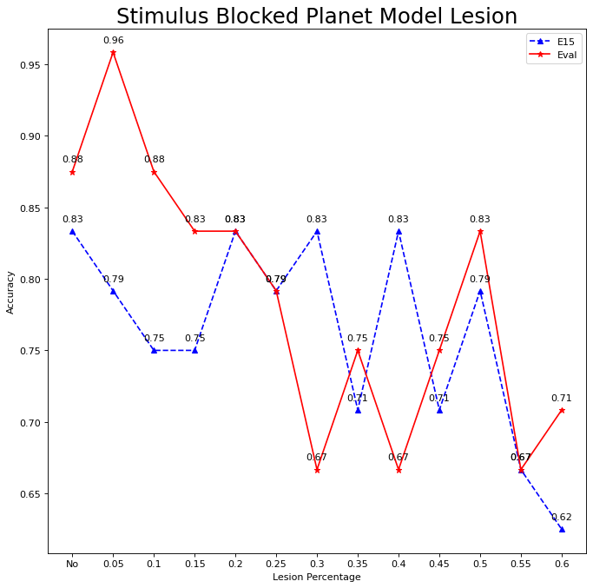
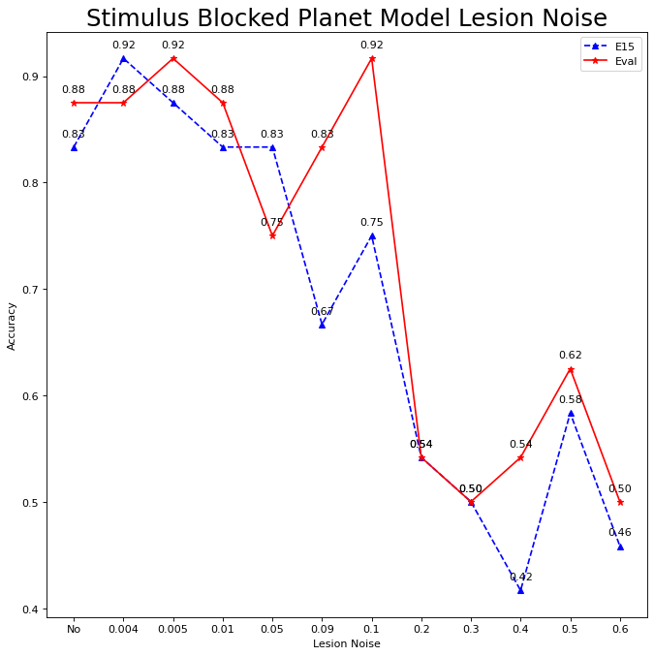

Slide 7
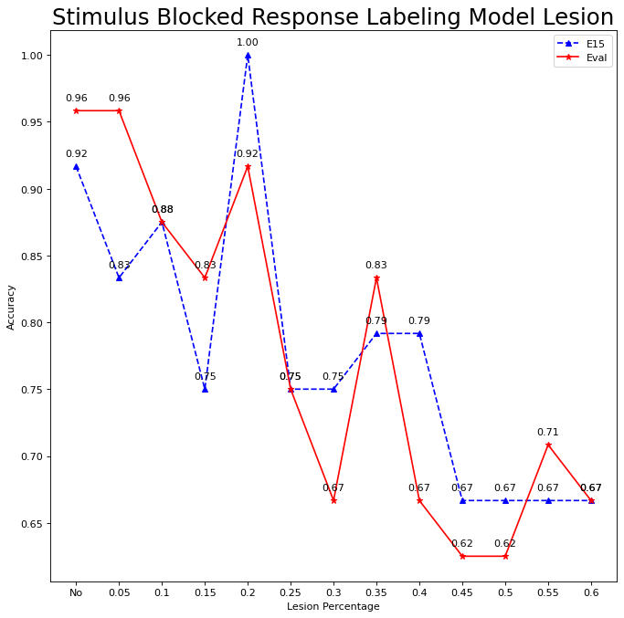
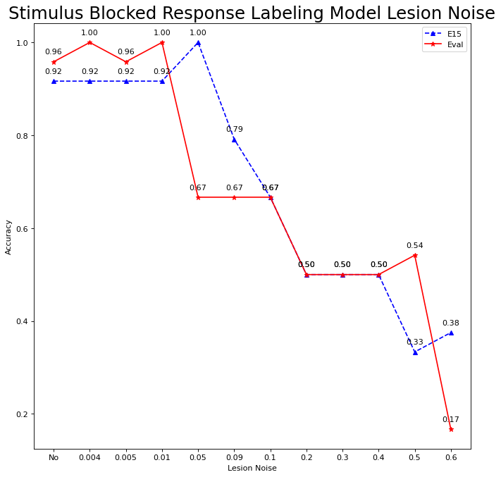

Slide 8
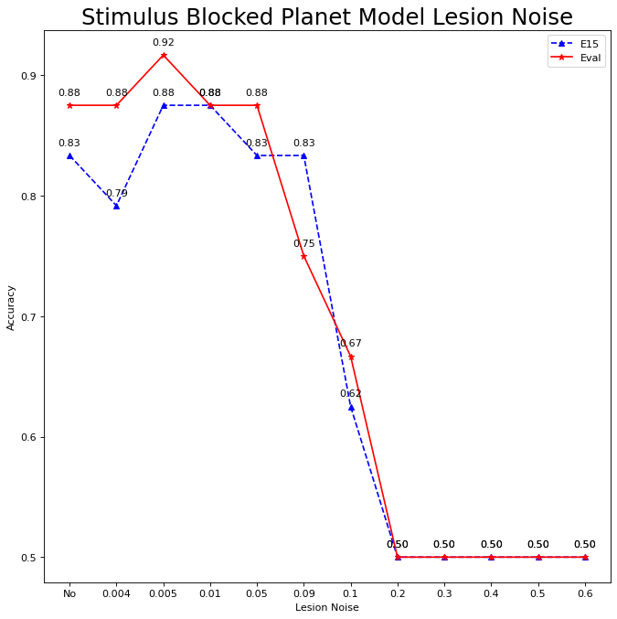
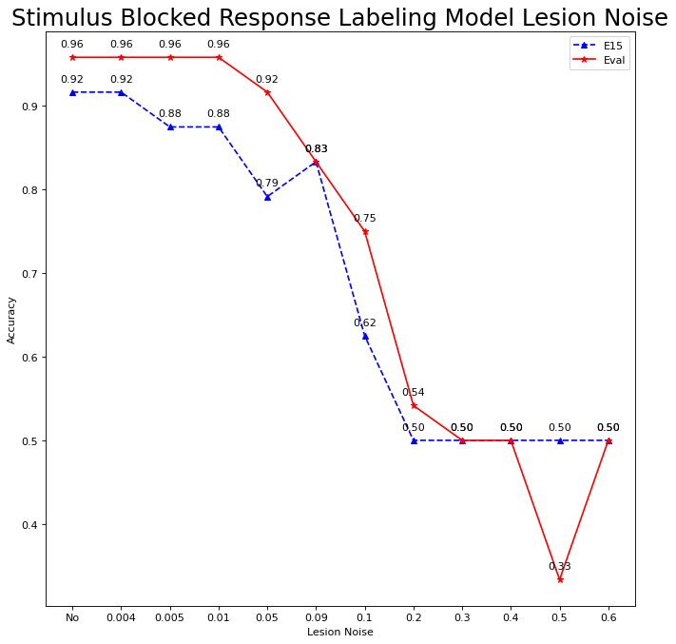

Slide 9
SAME SEED

Slide 10
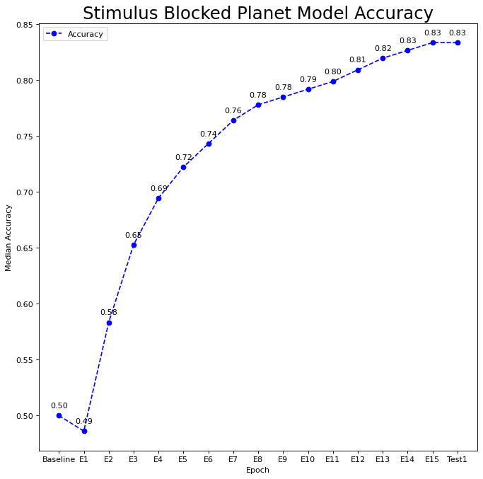
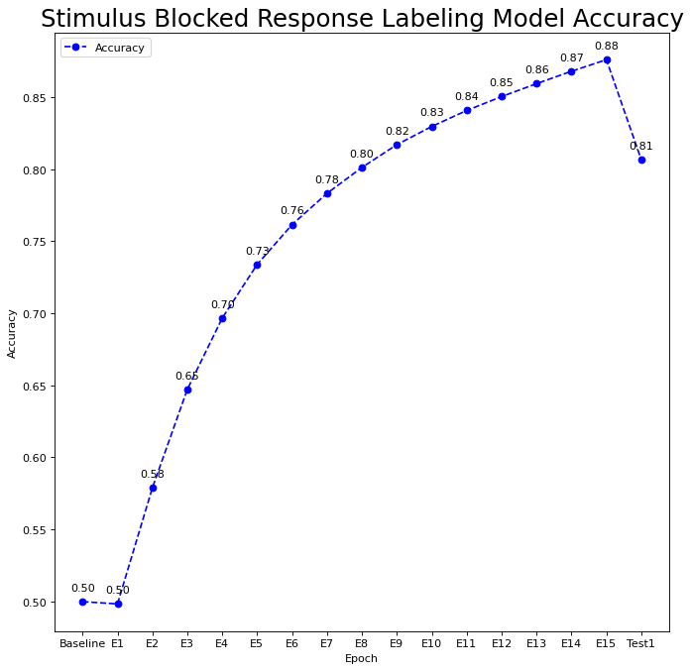
Models Accuracy Same Seed

Slide 11
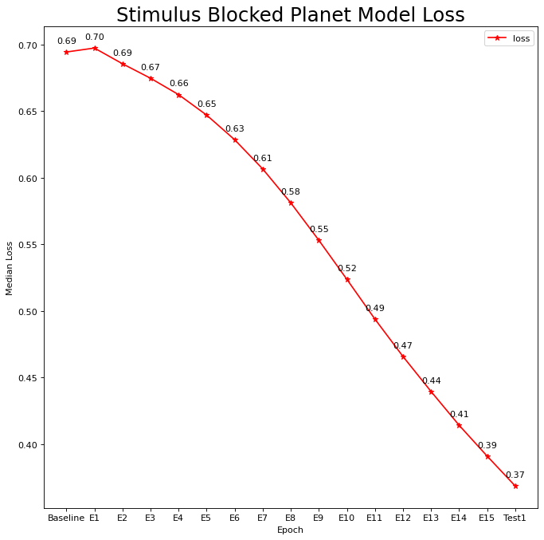
Models Loss same seed

Slide 12
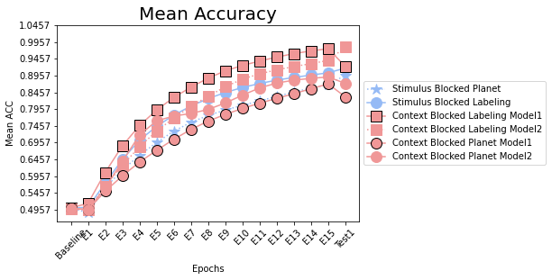


Slide 13
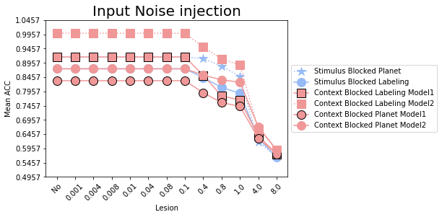

Slide 14
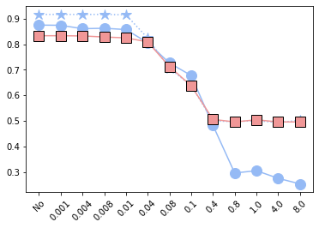

Slide 15
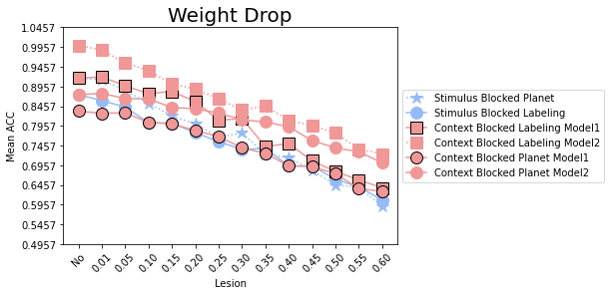

Slide 16
